Slide 1


CUSTOMER INTERFACE DESIGN AND DEVELOPMENT -SITA1502
Dr. M.Malini Deepika
DEPARTMENT OF COMPUTER SCIENCE AND ENGINEERING

Slide 2
UNIT 4 ANGULAR JS AND JQUERY
Angular JS Expression – Modules – Directives – Data Binding –Controllers – Scopes – Filters – Services – Tables – Events– Form – Validation. jQuery Syntax – Selects – Events – jQuery Effects – jQuery – jQuery HTML – jQuery Traversing.

Slide 3
What is AngularJS
MVC Javascript Framework by Google for Rich Web Application Development

Slide 4
Why AngularJS
Other frameworks deal with HTML’s shortcomings by either abstracting away HTML, CSS, and/or JavaScript or by providing an imperative way for manipulating the DOM.
Structure, Quality and Organization
Lightweight ( < 36KB compressed and minified)
Free
Separation of concern
Modularity
Extensibility & Maintainability
Reusable Components
“

Slide 5
Features of AngularJS
Two-way Data Binding – Model as single source of truth
Directives – Extend HTML
MVC
Dependency Injection
Testing
Deep Linking (Map URL to route Definition)
Server-Side Communication

Slide 6
MVC
Model (Data)
Model (Data)
View (UI)
Notifies
Notifies
Changes
Controller (Logic)

Slide 7
Directives
Directives are markers (such as attributes, tags, and class names) that tell AngularJS to attach a given behaviour to a DOM element (or transform it, replace it, etc.)
Some angular directives
The ng-app - Bootstrapping your app and defining its scope.
The ng-controller - defines which controller will be in charge of your view.
The ng-repeat - Allows for looping through collections

Slide 8
Directives
ng-app
ng-model
ng-bind
ng-controller
ng-value
ng-show
ng-hide
ng-init
ng-click
ng- disable
ng-required
ng-repeat

Slide 9
kinds of directives in Angular
There are three kinds of directives in Angular:
Components— directives with a template.
Structural directives— change the DOM layout by adding and removing DOM elements.
Attribute directives— change the appearance or behavior of an element, component, or another directive.

Slide 10
Directives
Structural Directives change the structure of the view. Two examples are NgFor and NgIf.
Structural directives are easy to recognize. An asterisk (*) precedes the directive attribute name as in this.
Attribute directives are used as attributes of elements. The built-in NgStyle directive in the Template
Three of the common, built-in structural directives—NgIf, NgFor, and NgSwitch.

Slide 11
NgIf
<div *ngIf="hero" class="name">{{hero.name}}</div>
No brackets. No parentheses. Just *ngIf set to a string.
The asterisk (*) is a convenience notation and the string is a micro syntax rather than the usual template
expression.
Angular desugars this notation into a marked-up <ng-template> that surrounds the host element and its
descendents. Each structural directive does something different with that template.
https://www.ifourtechnolab.com/

Slide 12
NgFor
<ul>
<li *ngFor="let hero of heroes">{{hero.name}}</li>
</ul>
Ref -> https://blog.angular-university.io/angular-2-ngfor/
❏ Angular transforms the *ngFor in similar fashion from asterisk (*) syntax to <ng-template> element.
Angular transforms the *ngFor in similar fashion from asterisk (*) syntax to <ng-template> element.

Slide 13
NgSwitch
The Angular NgSwitch is actually a
set of cooperating directives:
NgSwitch,
NgSwitchCase
NgSwitchDefault

Slide 14
NgSwitch Example
<ul [ngSwitch]="person.country">
<li *ngSwitchCase="'UK'" class="text-success">
{{ person.name }} ({{ person.country }})
</li>
<li *ngSwitchCase="'USA'" class="text-primary">
{{ person.name }} ({{ person.country }})
</li>
<li *ngSwitchDefault class="text-warning">
{{ person.name }} ({{ person.country }})
</li>
</ul>

Slide 15
NgClass
Adds and removes CSS classes on an HTML element.
The CSS classes are updated as follows, depending on the type of the expression evaluation:
string - the CSS classes listed in the string (space delimited) are added,
Array - the CSS classes declared as Array elements are added,
Object - keys are CSS classes that get added when the expression given in the value evaluates to a truthy value, otherwise they are removed.
<some-element [ngClass]="'first second'">...</some-element>
<some-element [ngClass]="['first', 'second']">...</some-element>
<some-element [ngClass]="{'first': true, 'second': true, 'third': false}">...</some-element>
<some-element [ngClass]="string: Exp|array: Exp|obj: Exp">...</some-element>
<some-element [ngClass]="{'class1 class2 class3' : true}">...</some-element>

Slide 16
NgStyle
An attribute directive that updates styles for the containing HTML element.
Sets one or more style properties, specified as colon-separated key-value pairs.
The key is a style name, with an optional .
<unit> suffix (such as 'top.px', 'font-style.em').
The value is an expression to be evaluated.
The resulting non-null value, expressed in the given unit, is assigned to the given style property.
If the result of evaluation is null, the corresponding style is removed.
<some-element [ngStyle]="{'font-style': styleExp}">...</some-element>
<some-element [ngStyle]="{'max-width.px': widthExp}">...</some-element>
<some-element [ngStyle]="objExp">...</some-element>

Slide 17
Expressions
Expressions allow you to execute some computation in order to return a desired value.
{{ 1 + 1 }}
{{ 946757880 | date }}
{{ user.name }}
you shouldn’t use expressions to implement any higher-level logic.

Slide 18
What is module ?
An AngularJS module defines an application.
The module is container for different parts of an application.I.e controllers,services,directives,filters.
Controllers always belong to a module.
Module is used as a main() method.angular is an object and module is a method. Module is which present in angular object.

Slide 19
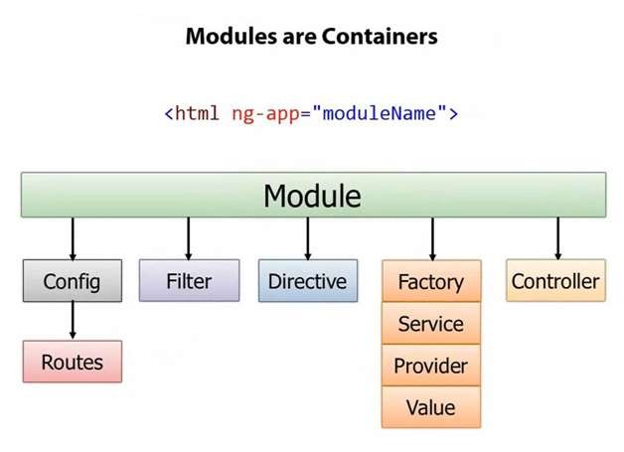

Slide 20
Why module
Module is starting point of angularjs application.
ng-app that have empty module make its controller function global.
Controller function will become global if we don’t register it with the module then there may be chances of overriding data. To avoid this we have register controller function with the module.
So that can solve global value problem.

Slide 21
How to create a module
Syntax:
Var app = angular.module(“myModule”, []);

Slide 22
How to add controller to Module
var myApp=angular.module("myModule",[])
myApp.controller("myController",function($scope){ //Register the controller with the module.
});

Slide 23
Sample Program for Angularjs
Step:2 you need to include the AngularJS JavaScript file in the HTML page so we can use AngularJS:
<!DOCTYPE html>
<html>
<head>
<script src="https://ajax.googleapis.com/ajax/libs/angularjs/1.2.5/angular.min.js"></script>
</head>
<body>
.
.
</body>
</html>
Step 1 The first thing you need is an HTML page
<!DOCTYPE html>
<html>
<head>
.
.
</head>
<body>
.
.
</body>
</html>

Slide 24
Modules and controlers
<div ng-controller="HelloController" >
<h2>Hello {{helloTo.title}} !</h2>
</div>
<script>
angular.module("myapp", [])
.controller("HelloController", function($scope) {
$scope.helloTo = {};
$scope.helloTo.title = "World, AngularJS";
});
</script>
<!DOCTYPE html>
<html lang="en">
<head>
<script src="https://ajax.googleapis.com/ajax/libs/angularjs/1.2.5/angular.min.js"></script>
</head>
<body ng-app="myapp">
<div ng-controller="HelloController" >
<h2>Hello {{helloTo.title}} !</h2>
</div>
<script>
angular.module("myapp", [])
.controller("HelloController", function($scope) {
$scope.helloTo = {};
$scope.helloTo.title = "World, AngularJS";
} );
</script> </body> </html>

Slide 25
<html>
<head>
<title>AngularJS Directives</title>
</head>
<body>
<h1>Sample Application</h1>
<div ng-app = "" ng-init = "countries = [{locale:'en-US',name:'United States'},
{locale:'en-GB',name:'United Kingdom'}, {locale:'en-FR',name:'France'}]">
<p>Enter your Name: <input type = "text" ng-model = "name"></p>
<p>Hello <span ng-bind = "name"></span>!</p>
<p>List of Countries with locale:</p>
<ol>
</body>
</html>
<li ng-repeat = "country in countries">
{{ 'Country: ' + country.name + ', Locale: ' + country.locale }}
</li>
</ol>
</div>
<script src = "https://ajax.googleapis.com/ajax/libs/angularjs/1.3.14/angular.min.js">
</script>

Slide 26
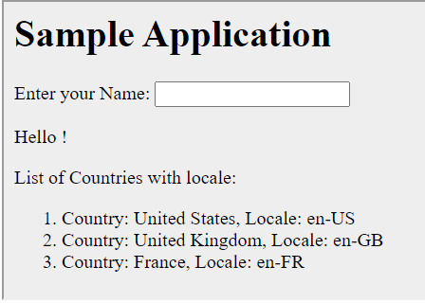

Slide 27
Controllers
AngularJS application mainly relies on controllers to control the flow of data in the application.
A controller is defined using ng-controller directive.
A controller is a JavaScript object that contains attributes/properties, and functions.
Each controller accepts $scope as a parameter, which refers to the application/module that the controller needs to handle.

Slide 28
Example
<div ng-app = "" ng-controller = "studentController">
...
</div>
Here, we declare a controller named studentController, using the ng-controller directive

Slide 29
Scope in a Directive
This scope object is used for accessing the variables and functions defined in the AngularJS controllers
The controller and link functions of the directive
By default, directives do not create their own scope; instead they use the scope of their parent, generally a controller (within the scope of which the directive is defined)

Slide 30
Scope in a Directive
We can change the default scope of the directive using the scope field of the DDO (Data Definition Object)
Note that scope is a property of the directive, just like restrict, template, etc. The value of the scope field defines how the scope of the directive will be created and used. These values are ‘true’, ‘false,’ and ‘{}’

Slide 31
scope: false
This is the default value of scope in the directive definition. In this case, the directive has the same scope as its parent controller.

Slide 32
scope: false
Creating an Angular app and controller
var movieApp = angular.module("movieApp",[]);
movieApp.controller("movieController",function($scope){
$scope.movie = "Ice Age";
});

Slide 33
Defining the directive movieApp.directive("movieDirective", function(){ return { restrict: "E", scope: false, template: "<div>Movie title : {{movie}}</div>"+ "Type a new movie title : <input type='text' ng-model='movie' />" }; });
Finally, embedding the directive in HTML
<div ng-app="movieApp"> <div ng-controller="movieController"> <h2>Movie: {{movie}}</h2> Change Movie Title : <input type='text' ng-model='movie'/>

Slide 34
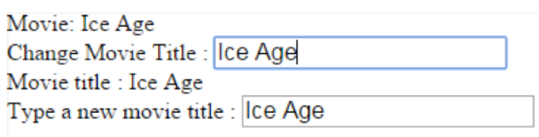
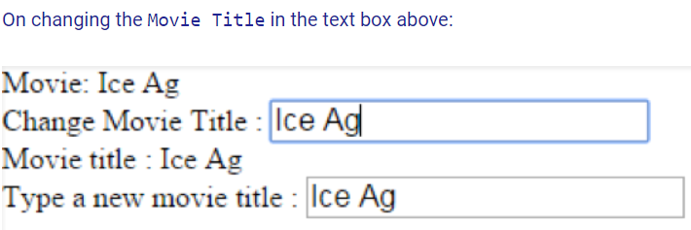
scope: false
Output

Slide 35
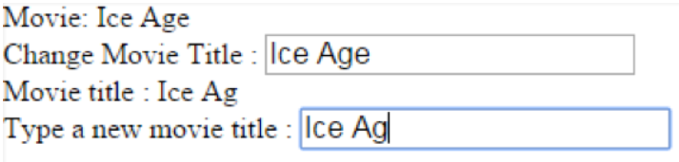
Output

Slide 36
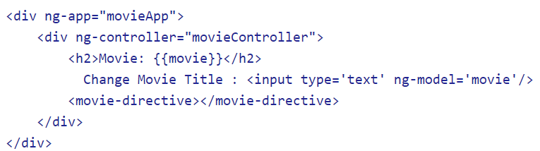
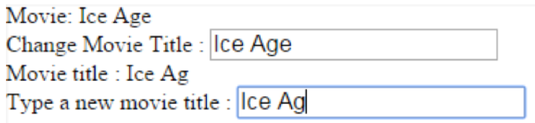
scope: true
Let’s change the scope field of the directive in the last example to true
scope: true

Slide 37
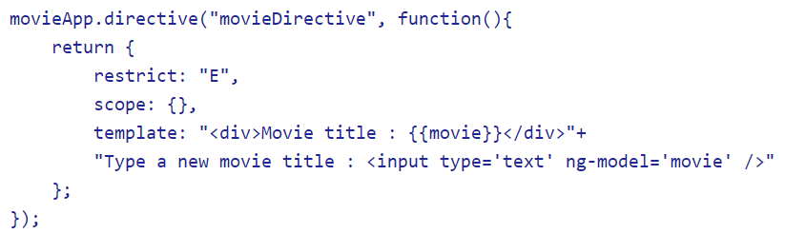
scope: {}
This is how the directive gets its isolated scope. We pass an object for the scope field in this case. This way, the scope of the directive is not inherited from the parent and is instead completely detached from it. Thus, the directive has an isolated scope.

Slide 38
Isolated scope - Prefixes
The directive scope uses prefixes to achieve that.
Using prefixes helps establish a two-way or one-way binding between parent and directive scopes, and also make calls to parent scope methods.
To access any data in the parent scope requires passing the data at two places – the directive scope and the directive tag.

Slide 39
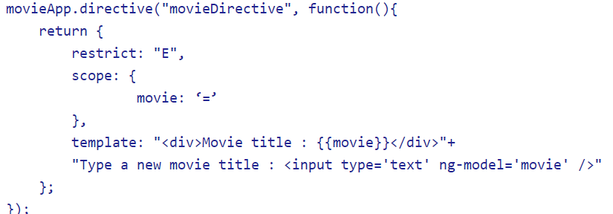
Passing data to the directive scope

Slide 40
2. Passing data in the directive tag
<movie-directive movie="movie"></movie-directive>
There are 3 types of prefixes in AngularJS:
'@' - Text binding / one-way binding
'=' - Direct model binding / two-way binding
'&' - Behavior binding / Method binding

Slide 41
Modifying the controller
movieApp.controller("movieController",function($scope){ $scope.movie = "Ice Age"; $scope.rating = 5; $scope.display = function(movie) { alert("Movie : " + movie); } });

Slide 42
Modifying the directive
movieApp.directive("movieDirective", function(){ return { restrict: "E", scope: { movie: '=', rating: '@', display: '&' }, template: "<div>Movie title : {{movie}}</div>"+ "Type a new movie title : <input type='text' ng-model='movie' />"+ "<div>Movie rating : {{rating}}</div>"+ "Rate the movie : <input type='text' ng-model='rating' />"+ "<div><button ng-click='display(movie)'>View Movie</button></div>" }; });

Slide 43
Passing the ¦elds in the directive tag
<div ng-app="movieApp"> <div ng-controller="movieController"> <h2>Movie Name : {{movie}}</h2> <h3>Rating : {{rating}}</h3> <movie-directive movie="movie" rating="{{rating}}" display="display(m </movie-directive> </div> </div>

Slide 44
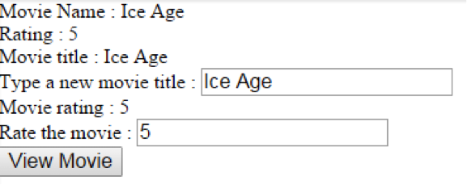
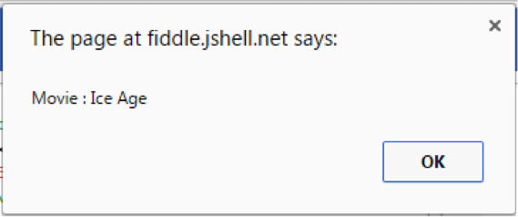

Slide 45
Data Binding in Angular
Types of Data Binding in Angular
1. Interpolation:
The type of one-way data binding where text is between a set of curly braces often uses the name of a component property.
The syntax of string interpolation is to use double curly braces.
{{ Var-name }}

Slide 46
2: Property Binding:
Property Binding allows us to bind the view of the template expression. Property binding in simple term is defined as updating the value of a certain variable in component (model) and displaying it in view (presentation layer).
This is a one-way mechanism; thus, it allows you to change the value whenever you want but only at the component level.
binding.component.html
<h1>PropertyBinding</h1><img
[src]="imagePath" class="image-adjustment"/><br>

Slide 47
binding.component.ts
import { Component, OnInit } from '@angular/core';@Component({ selector: 'app-binding', templateUrl: './binding.component.html', styleUrls: ['./binding.component.css']})export class BindingComponent implements OnInit { constructor() { } imagePath: string = 'assets/images/Databinding.png'; ngOnInit() {} }}

Slide 48
3: Event Binding:
Event binding is defined as the updating/sending of the value/information of a certain variable from the presentation layer (view) to the component (model). For example, clicking a button.
binding.component.html
<h1 Event Binding></h1><h1>{{title}}</h1><button (click)="changeMyTitle()">Title is changed on click of this button.</button>

Slide 49
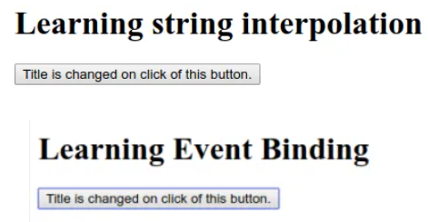
Sample Program
binding.component.ts
export class BindingComponent implements OnInit { constructor() { } title = 'Learning string interpolation'; ngOnInit() { }changeMyTitle() { this.title = 'Learning Event Binding’;}}
Output:

Slide 50
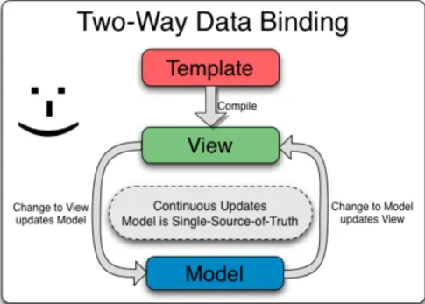
4: Two-Way Data Binding:
Two-way data binding is a combination of both Property and Event binding and it is a continuous synchronization of a data from view to the component and component to the view.

Slide 51
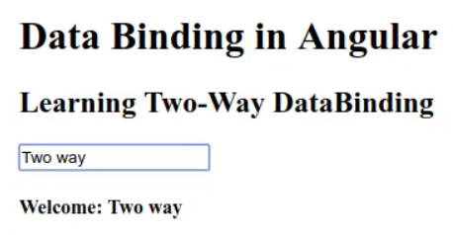
Sample Program
binding.component.html
<h1>Data Binding in Angular</h1><h2>Learning Two-Way DataBinding</h2><input type = "text" [(ngModel)]="userName"/><br><h4>Welcome: {{userName}}</h4>
Output

Slide 52
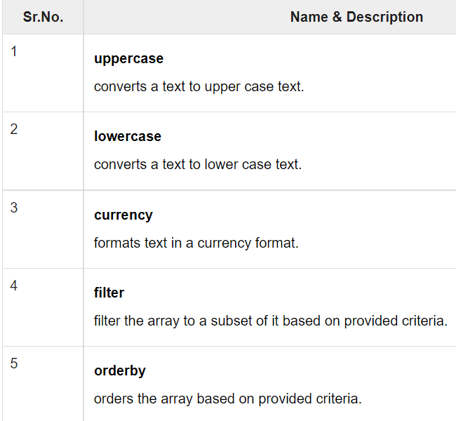
Filters
Filters are used to modify the data. They can be clubbed in expression or directives using pipe (|) character. The following list shows the commonly used filters.

Slide 53
2. Uppercase Filter
Add uppercase filter to an expression using pipe character. Here we've added uppercase filter to print student name in all capital letters.
Enter first name:<input type = "text" ng-model = "student.firstName">
Enter last name: <input type = "text" ng-model = "student.lastName">
Name in Upper Case: {{student.fullName() | uppercase}}

Slide 54

3. Lowercase Filter
Add lowercase filter to an expression using pipe character. Here we've added lowercase filter to print student name in all lowercase letters.

Slide 55

4. Currency Filter
Add currency filter to an expression returning number using pipe character. Here we've added currency filter to print fees using currency format.

Slide 56
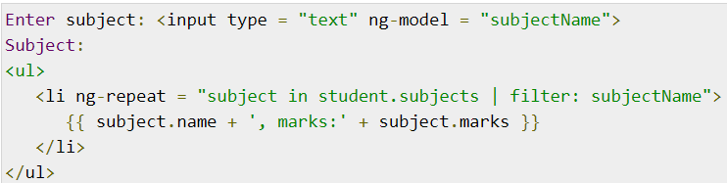
4. Filter
To display only required subjects, we use subjectName as filter.

Slide 57
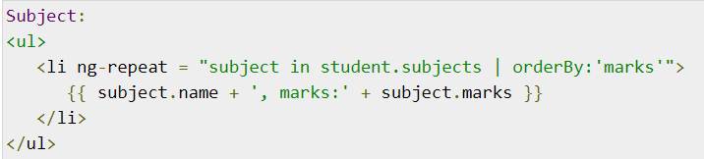
5. OrderBy Filter
To order subjects by marks, we use orderBy marks.

Slide 58
Service
In AngularJS, a service is a function, or object, that is available for, and limited to, your AngularJS application.
AngularJS has about 30 built-in services.
Syntax
$location
Example
var app = angular.module('myApp', []); app.controller('customersCtrl', function($scope, $location) { $scope.myUrl = $location.absUrl(); });

Slide 59
Registering Services
Typically you use the Module factory API to register a service
The service factory function generates the single object or function that represents the service to the rest of the application. The object or function returned by the service is injected into any component (controller, service, filter or directive) that specifies a dependency on the service.

Slide 60
Dependencies
Services can have their own dependencies. Just like declaring dependencies in a controller, you declare dependencies by specifying them in the service's factory function signature.

Slide 61
Registering a Service with $provide
You can also register services via the $provide service inside of a module's config function
This technique is often used in unit tests to mock out a service's dependencies.
angular.module('myModule', []).config(['$provide', function($provide) {
$provide.factory('serviceId', function() {
var shinyNewServiceInstance;
// factory function body that constructs shinyNewServiceInstance
return shinyNewServiceInstance;
});
}]);

Slide 62
The $timeout Service
The $timeout service is AngularJS' version of the window.setTimeout function.
var app = angular.module('myApp', []); app.controller('myCtrl', function($scope, $timeout) { $scope.myHeader = "Hello World!"; $timeout(function () { $scope.myHeader = "How are you today?"; }, 2000); });

Slide 63
AngularJS $http
The AngularJS $http service makes a request to the server, and returns a response.
Make a simple request to the server, and display the result in a header:
<div ng-app="myApp" ng-controller="myCtrl"> <p>Today's welcome message is:</p> <h1>{{myWelcome}}</h1> </div> <script>
var app = angular.module('myApp', []); app.controller('myCtrl', function($scope, $http) { $http.get("welcome.htm") .then(function(response) { $scope.myWelcome = response.data; }); });
</script>

Slide 64
The .get method is a shortcut method of the $http service. There are several shortcut methods:
.delete()
.get()
.head()
.jsonp()
.patch()
.post()
.put()

Slide 65
var app = angular.module('myApp', []); app.controller('myCtrl', function($scope, $http) { $http({ method : "GET", url : "welcome.htm" }).then(function mySuccess(response) { $scope.myWelcome = response.data; }, function myError(response) { $scope.myWelcome = response.statusText; }); });

Slide 66
Properties
The response from the server is an object with these properties:
.config the object used to generate the request.
.data a string, or an object, carrying the response from the server.
.headers a function to use to get header information.
.status a number defining the HTTP status.
.statusText a string defining the HTTP status.

Slide 67

TABLE
Table data is generally repeatable.
if we want to show data in table formats it’s better to use ng-repeat directive because the table will contain data in repeated format.
In angularjs the ng-repeat directive will loop through the array data objects in the DOM elements and help us to show data in tables easily.

Slide 68
Example Table
<table>
<tr>
<th>Name</th>
<th>Marks</th>
</tr> <tr ng-repeat = "subject in student.subjects">
<td>{{ subject.name }}</td>
<td>{{ subject.marks }}</td>
</tr>
</table>

Slide 69
var app = angular.module('myApp', []); app.controller('myCtrl', function($scope, $http) { $http.get("welcome.htm") .then(function(response) { $scope.content = response.data; $scope.statuscode = response.status; $scope.statustext = response.statusText; }); });

Slide 70
Table can be styled using CSS Styling.
<style>
table, th , td { border: 1px solid grey; border-collapse: collapse; padding: 5px; }
table tr:nth-child(odd) { background-color: #f2f2f2; }
table tr:nth-child(even) { background-color: #ffffff; }
</style>

Slide 71
Display with orderBy Filter
To sort the table, add an orderBy filter:
<table> <tr ng-repeat="x in names | orderBy : 'Country'"> <td>{{ x.Name }}</td> <td>{{ x.Country }}</td> </tr> </table>

Slide 72
Display with uppercase Filter
To display uppercase, add an uppercase filter:
<table> <tr ng-repeat="x in names"> <td>{{ x.Name }}</td> <td>{{ x.Country | uppercase }}</td> </tr> </table>

Slide 73
Display the Table Index ($index)
To display the table index, add a <td> with $index:
<table> <tr ng-repeat="x in names"> <td>{{ $index + 1 }}</td> <td>{{ x.Name }}</td> <td>{{ x.Country }}</td> </tr> </table>

Slide 74
Using $even and $odd
<table> <tr ng-repeat="x in names"> <td ng-if="$odd" style="background-color:#f1f1f1">{{ x.Name }}</td> <td ng-if="$even">{{ x.Name }}</td> <td ng-if="$odd" style="background-color:#f1f1f1">{{ x.Country }}</td> <td ng-if="$even">{{ x.Country }}</td> </tr> </table>

Slide 75
EVENTS
The event directives allows us to run AngularJS functions at certain user events.
An AngularJS event will not overwrite an HTML event, both events will be executed.
ng-blur
ng-change
ng-click
ng-copy
ng-cut
ng-dblclick

Slide 76
ng-keyup
ng-mousedown
ng-mouseenter
ng-mouseleave
ng-mousemove
ng-mouseover
ng-mouseup
ng-paste
ng-focus
ng-keydown
ng-keypress

Slide 77
Mouse Events
Mouse events occur when the cursor moves over an element, in this order:
ng-mouseover
ng-mouseenter
ng-mousemove
ng-mouseleave

Slide 78
Or when a mouse button is clicked on an element, in this order:
ng-mousedown
ng-mouseup
ng-click
You can add mouse events on any HTML element.

Slide 79
Example
Increase the count variable when the mouse moves over the H1 element:
<div ng-app="myApp" ng-controller="myCtrl"> <h1 ng-mousemove="count = count + 1">Mouse over me!</h1> <h2>{{ count }}</h2> </div> <script> var app = angular.module('myApp', []); app.controller('myCtrl', function($scope) { $scope.count = 0; }); </script>

Slide 80
Forms
Forms in AngularJS provides data-binding and validation of input controls.
Input Controls
Input controls are the HTML input elements:
input elements
select elements
button elements
textarea elements

Slide 81
Example
<script> var app = angular.module('myApp', []); app.controller('formCtrl', function($scope) { $scope.firstname = "John"; }); </script>
It can also be referred to elsewhere in the application:

Slide 82
Example
<form> First Name: <input type="text" ng-model="firstname"> </form> <h1>You entered: {{firstname}}</h1>

Slide 83
Checkbox
A checkbox has the value true or false. Apply the ng-model directive to a checkbox, and use its value in your application.
Example
Show the header if the checkbox is checked:
<form> Check to show a header: <input type="checkbox" ng-model="myVar"> </form> <h1 ng-show="myVar">My Header</h1>

Slide 84
Radiobuttons
Bind radio buttons to your application with the ng-model directive.
Radio buttons with the same ng-model can have different values, but only the selected one will be used.
Example
Display some text, based on the value of the selected radio button:
<form> Pick a topic: <input type="radio" ng-model="myVar" value="dogs">Dogs <input type="radio" ng-model="myVar" value="tuts">Tutorials <input type="radio" ng-model="myVar" value="cars">Cars </form>
The value of myVar will be either dogs, tuts, or cars.

Slide 85
Selectbox
Bind select boxes to your application with the ng-model directive.
The property defined in the ng-model attribute will have the value of the selected option in the selectbox.
Example
Display some text, based on the value of the selected option:
<form> Select a topic: <select ng-model="myVar"> <option value=""> <option value="dogs">Dogs <option value="tuts">Tutorials <option value="cars">Cars </select> </form>
The value of myVar will be either dogs, tuts, or cars.

Slide 86
Form Validation
AngularJS offers client-side form validation.
AngularJS monitors the state of the form and input fields (input, textarea, select), and lets you notify the user about the current state.
AngularJS also holds information about whether they have been touched, or modified, or not.
You can use standard HTML5 attributes to validate input, or you can make your own validation functions.
Client-side validation cannot alone secure user input. Server side validation is also necessary.

Slide 87
Use the HTML5 attribute required to specify that the input field must be filled out:
The input field is required:
<form name="myForm"> <input name="myInput" ng-model="myInput" required> </form> <p>The input's valid state is:</p> <h1>{{myForm.myInput.$valid}}</h1>

Slide 88
E-mail
Use the HTML5 type email to specify that the value must be an e-mail:
Example
The input field has to be an e-mail:
<form name="myForm"> <input name="myInput" ng-model="myInput" type="email"> </form> <p>The input's valid state is:</p> <h1>{{myForm.myInput.$valid}}</h1>

Slide 89
Form State and Input State
AngularJS is constantly updating the state of both the form and the input fields.
Input fields have the following states:
$untouched The field has not been touched yet
$touched The field has been touched
$pristine The field has not been modified yet
$dirty The field has been modified
$invalid The field content is not valid
$valid The field content is valid

Slide 90
They are all properties of the input field, and are either true or false.
Forms have the following states:
$pristine No fields have been modified yet
$dirty One or more have been modified
$invalid The form content is not valid
$valid The form content is valid
$submitted The form is submitted

Slide 91
They are all properties of the form, and are either true or false.
You can use these states to show meaningful messages to the user. Example, if a field is required, and the user leaves it blank, you should give the user a warning:
Example
Show an error message if the field has been touched AND is empty:
<input name="myName" ng-model="myName" required> <span ng-show="myForm.myName.$touched && myForm.myName.$invalid">The name is required.</span>

Slide 92
CSS Classes
AngularJS adds CSS classes to forms and input fields depending on their states.
The following classes are added to, or removed from, input fields:
ng-untouched The field has not been touched yet
ng-touched The field has been touched
ng-pristine The field has not been modified yet
ng-dirty The field has been modified

Slide 93
ng-valid The field content is valid
ng-invalid The field content is not valid
ng-valid-key One key for each validation. Example: ng-valid-required, useful when there are more than one thing that must be validated
ng-invalid-key Example: ng-invalid-required

Slide 94
The classes are removed if the value they represent is false.
Add styles for these classes to give your application a better and more intuitive user interface.
Example
Apply styles, using standard CSS:
<style>
input.ng-invalid { background-color: pink; } input.ng-valid { background-color: lightgreen; }
</style>

Slide 95
Forms can also be styled:
Example
Apply styles for unmodified (pristine) forms, and for modified forms:
<style> form.ng-pristine { background-color: lightblue; } form.ng-dirty { background-color: pink; } </style>

Slide 96
Custom Validation
To create your own validation function is a bit more tricky; You have to add a new directive to your application, and deal with the validation inside a function with certain specified arguments.
Example
Create your own directive, containing a custom validation function, and refer to it by using my-directive.
The field will only be valid if the value contains the character "e":

Slide 97
Select
AngularJS lets you create dropdown lists based on items in an array, or an object.
Creating a Select Box Using ng-options
If you want to create a dropdown list, based on an object or an array in AngularJS, you should use the ng-options directive:
Example
<div ng-app="myApp" ng-controller="myCtrl"> <select ng-model="selectedName" ng-options="x for x in names"> </select> </div>

Slide 98
<script> var app = angular.module('myApp', []); app.controller('myCtrl', function($scope) { $scope.names = ["Emil", "Tobias", "Linus"]; }); </script>
ng-options vs ng-repeat
You can also use the ng-repeat directive to make the same dropdown list:

Slide 99
Example
<select> <option ng-repeat="x in names">{{x}}</option> </select>
Because the ng-repeat directive repeats a block of HTML code for each item in an array, it can be used to create options in a dropdown list, but the ng-options directive was made especially for filling a dropdown list with options.

Slide 100
You can use both the ng-repeat directive and the ng-options directive:
Assume you have an array of objects:
$scope.cars = [ {model : "Ford Mustang", color : "red"}, {model : "Fiat 500", color : "white"}, {model : "Volvo XC90", color : "black"} ];
Example
Using ng-repeat:
<select ng-model="selectedCar"> <option ng-repeat="x in cars" value="{{x.model}}">{{x.model}}</option> </select> <h1>You selected: {{selectedCar}}</h1>

Slide 101
When using the value as an object, use ng-value insead of value:
Example
Using ng-repeat as an object:
<select ng-model="selectedCar"> <option ng-repeat="x in cars" ng-value="{{x}}">{{x.model}}</option> </select> <h1>You selected a {{selectedCar.color}} {{selectedCar.model}}</h1>

Slide 102
Example
Using ng-options:
<select ng-model="selectedCar" ng-options="x.model for x in cars"> </select> <h1>You selected: {{selectedCar.model}}</h1> <p>Its color is: {{selectedCar.color}}</p>
When the selected value is an object, it can hold more information, and your application can be more flexible.

Slide 103
The Data Source as an Object
In the previous examples the data source was an array, but we can also use an object.
Assume you have an object with key-value pairs:
$scope.cars = { car01 : "Ford", car02 : "Fiat", car03 : "Volvo" };
The expression in the ng-options attribute is a bit different for objects:

Slide 104
Example
Using an object as the data source, x represents the key, and y represents the value:
<select ng-model="selectedCar" ng-options="x for (x, y) in cars"> </select> <h1>You selected: {{selectedCar}}</h1>
The selected value will always be the value in a key-value pair.
The value in a key-value pair can also be an object:

Slide 105
Example
The selected value will still be the value in a key-value pair, only this time it is an object:
$scope.cars = { car01 : {brand : "Ford", model : "Mustang", color : "red"}, car02 : {brand : "Fiat", model : "500", color : "white"}, car03 : {brand : "Volvo", model : "XC90", color : "black"} };
The options in the dropdown list does not have to be the key in a key-value pair, it can also be the value, or a property of the value object:
Example
<select ng-model="selectedCar" ng-options="y.brand for (x, y) in cars"> </select>

Slide 106
jQuery
jQuery is designed to change the way that you write JavaScript (jQuery websitejQuery is a fast and concise JavaScript Library.
Simplifies HTML document traversing, event handling, animating, and Ajax interactions for rapid web development.

Slide 107
What is jQuery?
Write less code - what would take 20 lines or more of JavaScript can be achieved in just two or three lines of jQuery.
The same code runs in all browsers - there's no need to write special code for Internet Explorer.
It uses CSS selectors, leveraging knowledge that most web designers already have.

Slide 108
Adding the jQuery Library to Your Pages
The jQuery library is stored as a single JavaScript file, containing all the jQuery methods.
It can be added to a web page with the following mark-up:
<head><script
type="text/javascript"src="jquery.js">
</script> </head>

Slide 109
jQuery Syntax
The jQuery syntax is tailor made for selecting HTML elements and perform some action on the element(s).
Basic syntax is:
$(selector).action()
A dollar sign to define jQueryA (selector) to "query (or find)" HTML elementsA jQuery action() to be performed on the element(s)

Slide 110
jQuery Syntax Examples
$(this).hide() hides current element
$("p").hide() hides all paragraphs
$("p.test").hide() hides all paragraphs with
class="test"$("#test").hide() hides the element with id="test”

Slide 111
The Document Ready Function
All jQuery methods are inside a document.ready()function:
$(document).ready(function(){
// jQuery functions go here })
This is to prevent any jQuery code from running before the document is finished loading (is ready).

Slide 112
jQuery Selectors
jQuery selectors allow you to select and manipulate HTML elements as a group or as a single element.
jQuery selectors are required at every step while using jQuery.
Selectors allow you to get the exact element/attribute you want from your HTML document.
jQuery supports the existing CSS Selectors, and in addition, it has some own custom selectors.All type of selectors in jQuery, start with the dollar sign and parentheses: $().

Slide 113
Examples of jQuery Selectors
$("*") selects all elements
$("p") selects all <p> elements
$("p.intro") selects all <p> elements with class="intro"$("p#intro") selects the first <p> elements with id="intro
"$(":animated") selects all elements that are currently animated
$(":button") selects all <button> elements and <input> elements of type="button"$(":even") selects even elements
$(":odd") selects odd elements

Slide 114
jQuery Effects
Hide
Show
Toggle,
Slide
Fade
Animate.

Slide 115
Syntax:
$(selector).hide(speed,callback); $(selector).show(speed,callback);
The optional speed parameter specifies the speed of the hiding/showing, and can take the following values: "slow", "fast", or milliseconds.
The optional callback parameter is a function to be executed after the hide() or show() method completes (you will learn more about callback functions in a later chapter).

Slide 116
With jQuery, you can hide and show HTML elements with the hide() and show() methods:
Example
$("#hide").click(function(){ $("p").hide(); }); $("#show").click(function(){ $("p").show(); });

Slide 117
The following example demonstrates the speed parameter with hide():
Example
$("button").click(function(){ $("p").hide(1000); });

Slide 118
jQuery Fading Methods
With jQuery you can fade an element in and out of visibility.
jQuery has the following fade methods:
fadeIn()
fadeOut()
fadeToggle()
fadeTo()

Slide 119
jquery Effects - Fading
jQuery fadeIn() Demonstrates the jQuery fadeIn() method.
jQuery fadeOut() Demonstrates the jQuery fadeOut() method.
jQuery fadeToggle() Demonstrates the jQuery fadeToggle() method.
jQuery fadeTo() Demonstrates the jQuery fadeTo() method.

Slide 120
jQuery Effects - Sliding
The jQuery slide methods slide elements up and down.
Examples
jQuery slideDown() Demonstrates the jQuery slideDown() method.
jQuery slideUp() Demonstrates the jQuery slideUp() method.
jQuery slideToggle() Demonstrates the jQuery slideToggle() method.

Slide 121
jQuery Stop Animations
The jQuery stop() method is used to stop animations or effects before it is finished.
jQuery stop() sliding Demonstrates the jQuery stop() method.
jQuery stop() animation (with parameters) Demonstrates the jQuery stop() method.

Slide 122
jQuery Effects - Animation
With jQuery, you can create custom animations.
The jQuery animate() method is used to create custom animations.
Syntax:
$(selector).animate({params},speed,callback);
The required params parameter defines the CSS properties to be animated.
The optional speed parameter specifies the duration of the effect. It can take the following values: "slow", "fast", or milliseconds.

Slide 123
jQuery Callback Functions
A callback function is executed after the current effect is 100% finished.
JavaScript statements are executed line by line. However, with effects, the next line of code can be run even though the effect is not finished. This can create errors.
To prevent this, you can create a callback function.
A callback function is executed after the current effect is finished.
syntax: $(selector).hide(speed,callback);

Slide 124
jQuery HTML
jQuery - Get Content and Attributes
jQuery contains powerful methods for changing and manipulating HTML elements and attributes.
DOM = Document Object Model The DOM defines a standard for accessing HTML and XML documents:

Slide 125
Get Content - text(), html(), and val()
Three simple, but useful, jQuery methods for DOM manipulation are:
text() - Sets or returns the text content of selected elements
html() - Sets or returns the content of selected elements (including HTML markup)
val() - Sets or returns the value of form fields
attr() method is used to get attribute values

Slide 126
jQuery - Add Elements
Add New HTML Content
We will look at four jQuery methods that are used to add new content:
append() - Inserts content at the end of the selected elements
prepend() - Inserts content at the beginning of the selected elements
after() - Inserts content after the selected elements
before() - Inserts content before the selected elements

Slide 127
jQuery - Remove Elements
jQuery remove() Method
The jQuery remove() method removes the selected element(s) and its child elements.
jQuery empty() Method
The jQuery empty() method removes the child elements of the selected element(s).

Slide 128
jQuery - Get and Set CSS Classes
addClass() - Adds one or more classes to the selected elements
removeClass() - Removes one or more classes from the selected elements
toggleClass() - Toggles between adding/removing classes from the selected elements
css() - Sets or returns the style attribute

Slide 129
jQuery Traversing
jQuery traversing, which means "move through", are used to "find" (or select) HTML elements based on their relation to other elements. Start with one selection and move through that selection until you reach the elements you desire.
The image below illustrates an HTML page as a tree (DOM tree). With jQuery traversing, you can easily move up (ancestors), down (descendants) and sideways (siblings) in the tree, starting from the selected (current) element. This movement is called traversing - or moving through - the DOM tree.

Slide 130
llustration explained:
The <div> element is the parent of <ul>, and an ancestor of everything inside of it
The <ul> element is the parent of both <li> elements, and a child of <div>
The left <li> element is the parent of <span>, child of <ul> and a descendant of <div>
The <span> element is a child of the left <li> and a descendant of <ul> and <div>
The two <li> elements are siblings (they share the same parent)
The right <li> element is the parent of <b>, child of <ul> and a descendant of <div>
The <b> element is a child of the right <li> and a descendant of <ul> and <div>

Slide 131
An ancestor is a parent, grandparent, great-grandparent, and so on. A descendant is a child, grandchild, great-grandchild, and so on. Siblings share the same parent.

Slide 132
Traversing the DOM
jQuery provides a variety of methods that allow us to traverse the DOM.
The largest category of traversal methods are tree-traversal.
The next chapters will show us how to travel up, down and sideways in the DOM tree.

Slide 133
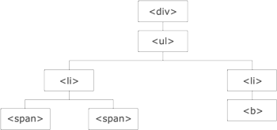
An ancestor is a parent, grandparent, great-grandparent, and so on. A descendant is a child, grandchild, great-grandchild, and so on. Siblings share the same parent.

Slide 134
jQuery Traversing - Ancestors
Traversing Up the DOM Tree
Three useful jQuery methods for traversing up the DOM tree are:
parent()
parents()
parentsUntil()

Slide 135
jQuery Traversing - Descendants
With jQuery you can traverse down the DOM tree to find descendants of an element.
A descendant is a child, grandchild, great-grandchild, and so on.
Traversing Down the DOM Tree
Two useful jQuery methods for traversing down the DOM tree are:
Children()
Find()

Slide 136
jQuery Traversing - Siblings
With jQuery you can traverse sideways in the DOM tree to find siblings of an element.
Siblings share the same parent.
Traversing Sideways in The DOM Tree
siblings()
next()
nextAll()
nextUntil()
prev()
prevAll()
prevUntil()

Slide 137
jQuery Traversing - Filtering
The first(), last(), eq(), filter() and not() Methods
The most basic filtering methods are first(), last() and eq(), which allow you to select a specific element based on its position in a group of elements.
Other filtering methods, like filter() and not() allow you to select elements that match, or do not match, a certain criteria.

